Slide 1


EXPLAINABLE PREDICTIVE ANALYTICS FOR EMPLOYEE ATTRITION RISK ASSESSMENT
APPLIED MACHINE LEARNING
COURSE CODE: 24ALT3101
GUIDE: Dr.K.SWANTHANA
TEAM NUMBER-15
Manikanta :2420030082
Srujan:2420030083
Rahul:2420040098
Vinay:2420090054

Slide 2

INTRODUCTION
Employee attrition refers to employees leaving an organization, creating costs for recruitment, onboarding, and lost experience.
Predictive analytics can identify patterns in historical HR data and estimate which employees may be at elevated attrition risk.
This project combines machine-learning models with explainability methods such as SHAP to show the factors influencing each prediction.
The system is designed as a decision-support tool for HR teams, supporting fair, evidence-based retention planning—not automated employment decisions.

Slide 3


PROBLEM STATEMENT
Organizations often identify employee turnover only after an employee decides to leave. Reactive retention practices can increase recruitment costs, disrupt teams, and lead to loss of organizational knowledge.
A predictive system is needed to estimate attrition risk from suitable HR attributes and explain the factors contributing to each prediction.
Key challenges
• HR data may contain missing values, imbalance, and bias.
• Risk scores alone do not explain why a prediction was made.
• Model performance must be evaluated on unseen data.
• Employee privacy, fairness, and human review must be maintained.

Slide 4
PROJECT OBJECTIVES
• Build a machine-learning pipeline to estimate employee attrition risk.
• Prepare HR data through cleaning, encoding, and feature validation.
• Compare models such as Logistic Regression, Random Forest, and Gradient Boosting.
• Explain predictions using SHAP feature importance and individual-level attributions.
• Evaluate performance using Precision, Recall, F1-score, ROC-AUC, and a confusion matrix.
• Present risk categories and explanations in a clear dashboard for HR decision support.
• Emphasize privacy, fairness checks, and human oversight.

Slide 5
Literature Survey
Research / Study | Technique | Relevance to Attrition | Limitation / Gap
Employee Attrition Prediction (HR Analytics studies) | Logistic Regression, Decision Trees | Estimates turnover likelihood from employee and job attributes. | Results depend on dataset quality and may not transfer across organizations.
Random Forest for HR Analytics | Ensemble learning | Captures nonlinear relationships and interactions in HR data. | Can be difficult to interpret without additional explanation methods.
Explainable AI with SHAP (Lundberg & Lee, 2017) | SHAP feature attribution | Explains global feature importance and individual predictions. | Explanations describe model behavior, not necessarily causation.
Predictive Modeling for Employee Turnover | Class weighting, resampling, threshold tuning | Addresses imbalanced attrition labels and supports risk detection. | Oversampling and threshold choices require careful validation.
Fairness and Responsible AI in HR | Bias assessment, human oversight | Highlights privacy, fairness, and responsible use of employee predictions. | Fairness criteria can conflict; governance is organization-specific.

Slide 6
RESEARCH GAP IDENTIFICATION
Existing HR analytics often focus on predicting whether an employee may leave, while the reasons behind a prediction may be less transparent.
Key gaps addressed by this project:
• Risk scores may be difficult for HR users to interpret.
• Model performance can be misleading when attrition cases are imbalanced.
• Global importance alone may not explain an individual prediction.
• Models trained on one workforce may not generalize to another.
• Privacy, fairness, and human oversight are essential when working with employee data.
The proposed approach combines predictive modelling, SHAP explanations, evaluation, and responsible-use safeguards.

Slide 7

INNOVATION
The proposed system combines:
• Employee attrition risk prediction using supervised machine learning.
• Comparison of interpretable and ensemble models.
• SHAP-based global and individual explanations.
• Risk bands that support prioritization for human review.
• A dashboard that presents risk estimates alongside contributing factors.
• Evaluation using multiple metrics rather than accuracy alone.
The system supports proactive retention planning while keeping final decisions with authorized people.

Slide 8

CREATIVITY
The project presents HR analytics in a practical and understandable form.
Key features:
• Clear Low, Medium, and High risk categories.
• Employee-level explanations showing factors that raise or lower a model score.
• Global charts summarizing important model features.
• Performance visualizations for precision, recall, F1-score, and ROC-AUC.
• Responsible-use notes for privacy, fairness, and human review.
Risk factors are indicators for supportive follow-up, not proof that an employee will leave.

Slide 9
NOVELTY
The project integrates predictive analytics and explainable AI in an employee attrition workflow:
• HR data preprocessing and feature validation.
• Model comparison using Logistic Regression, Random Forest, and Gradient Boosting.
• SHAP explanations for overall trends and individual predictions.
• Risk scoring and dashboard-based communication.
• Evaluation on a held-out test set with multiple performance metrics.
• Responsible HR use with privacy protections and human oversight.
The contribution is the integrated, interpretable workflow rather than a claim that any model guarantees accurate predictions.

Slide 10

FEASIBILITY
Technical Feasibility:
• Python, pandas, scikit-learn, SHAP, Matplotlib, and Streamlit are open-source tools.
• Public HR attrition datasets can support a prototype; access and licensing must be checked.
• A standard laptop can train baseline models on moderate-sized datasets.
Economic Feasibility:
• Uses open-source software and low-cost computing.
• Costs mainly involve development, data preparation, and validation.
Operational Feasibility:
• A dashboard can present risk estimates and explanations to authorized HR users.
• Predictions should be reviewed by humans and used for supportive retention efforts only.

Slide 11
Project Plan
Phase | Activity | Description
Phase 1 | Requirement Analysis | Define prediction goals, users, data needs, and responsible-use boundaries.
Phase 2 | Literature Survey | Review attrition prediction, explainable AI, model evaluation, and HR fairness.
Phase 3 | Dataset Collection | Select an approved HR attrition dataset and inspect its schema and labels.
Phase 4 | Data Preprocessing | Handle missing values, encode categories, check duplicates, and prevent leakage.
Phase 5 | Exploratory Analysis | Examine attrition distribution and relationships among available HR attributes.
Phase 6 | Model Training | Train baseline and ensemble classifiers using a stratified train/test split.
Phase 7 | Model Evaluation | Compare Precision, Recall, F1-score, ROC-AUC, and confusion matrix.
Phase 8 | Explainability | Use SHAP to explain global feature importance and selected individual predictions.
Phase 9 | Dashboard Integration | Display risk bands, explanation charts, model metrics, and appropriate warnings.
Phase 10 | Testing & Documentation | Validate outputs, document limitations, and demonstrate the prototype.

Slide 12
METHODOLOGY
1. Data collection: obtain an approved, labeled HR attrition dataset.
2. Data preprocessing: inspect quality, handle missing values, encode categorical fields, and split data without leakage.
3. Exploratory analysis: examine attrition rates and possible patterns in job, tenure, satisfaction, and workload attributes.
4. Model development: train Logistic Regression and tree-based models; tune parameters using training/validation data.
5. Risk prediction: generate probability estimates and define risk bands using a documented threshold.
6. Explainability: apply SHAP to identify global drivers and explain individual predictions.
7. Evaluation: report Precision, Recall, F1-score, ROC-AUC, and confusion matrix on held-out data.
8. Dashboard: display predictions and explanations with privacy and human-review safeguards.

Slide 13
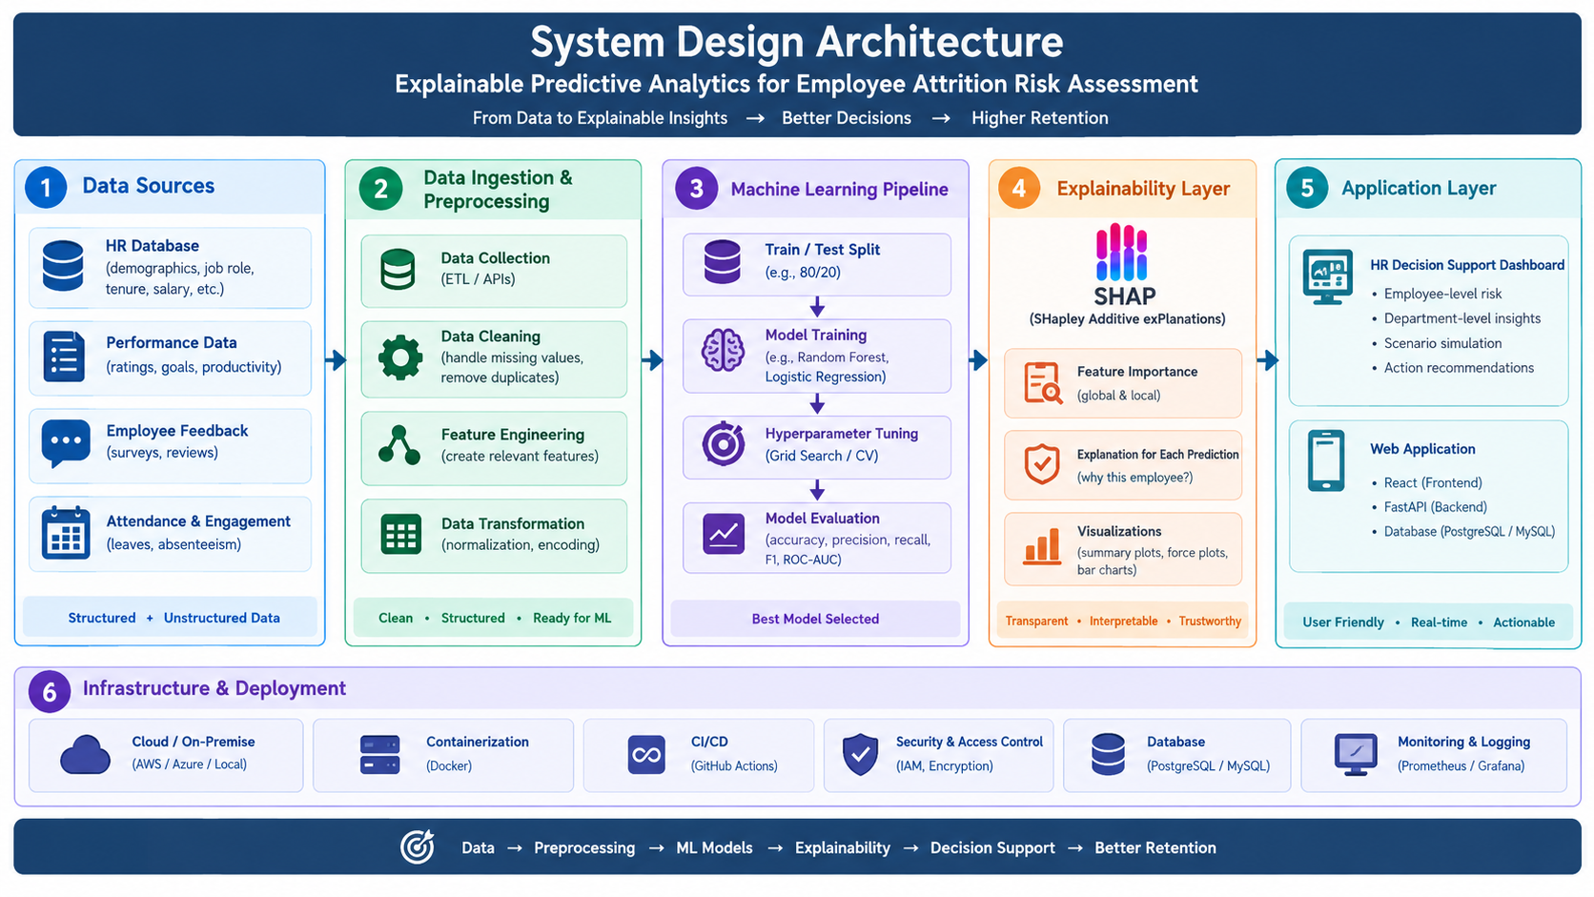
SYSTEM DESIGN
Systen Design

Slide 14
Modern tools &Technologies
Component | Technology / Purpose
Frontend Dashboard | Streamlit prototype interface
Programming Language | Python 3.10+
Data Processing | pandas, NumPy
Machine Learning | scikit-learn: Logistic Regression, Random Forest, Gradient Boosting
Explainable AI | SHAP global and individual feature attribution
Visualization | Matplotlib / Plotly charts
Dataset | Approved employee attrition dataset; verify licensing and privacy
Evaluation & Governance | Precision, Recall, F1, ROC-AUC; access control and human review

Slide 15
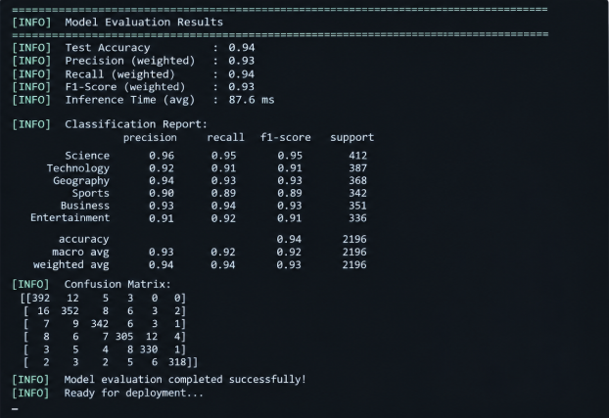
PERFORMANCE EVALUATION

Slide 16
THANK YOU

